Slide 1
Matrix Chain Multiplication
CLRS Chapter 15.1, 15.2, 15.3

Slide 2
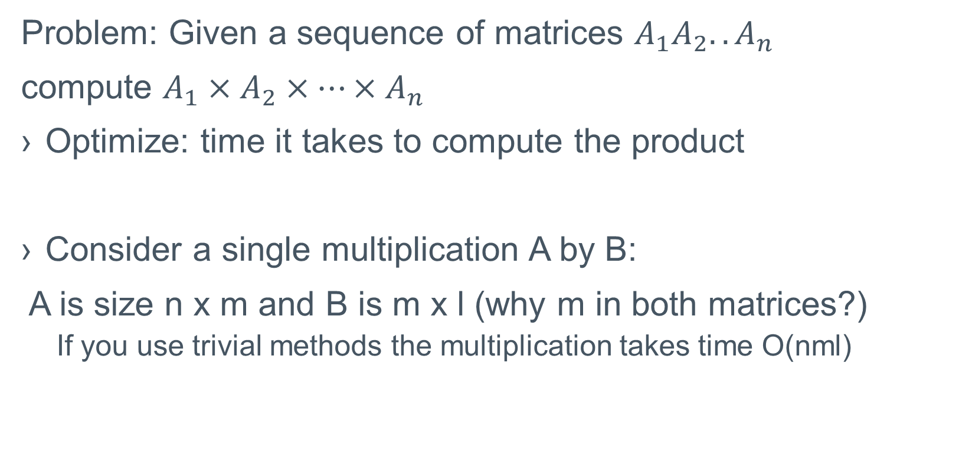
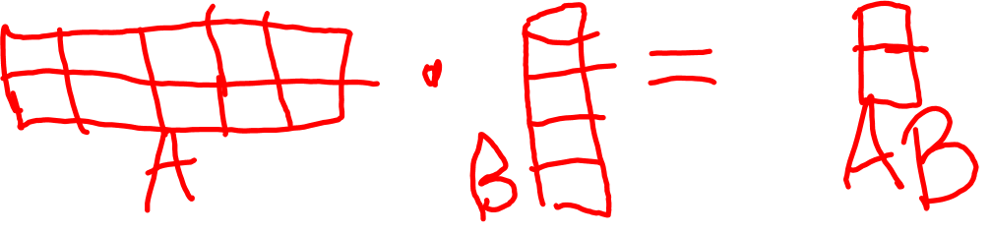
Matrix Chain Multiplication
Problem: Given a sequence of matrices $A_{1}A_{2}..A_{n}$
compute $A_{1}×A_{2}×…×A_{n}$
Optimize: time it takes to compute the product
Consider a single multiplication A by B:
A is size n x m and B is m x l (why m in both matrices?)
If you use trivial methods the multiplication takes time O(nml)

Slide 3
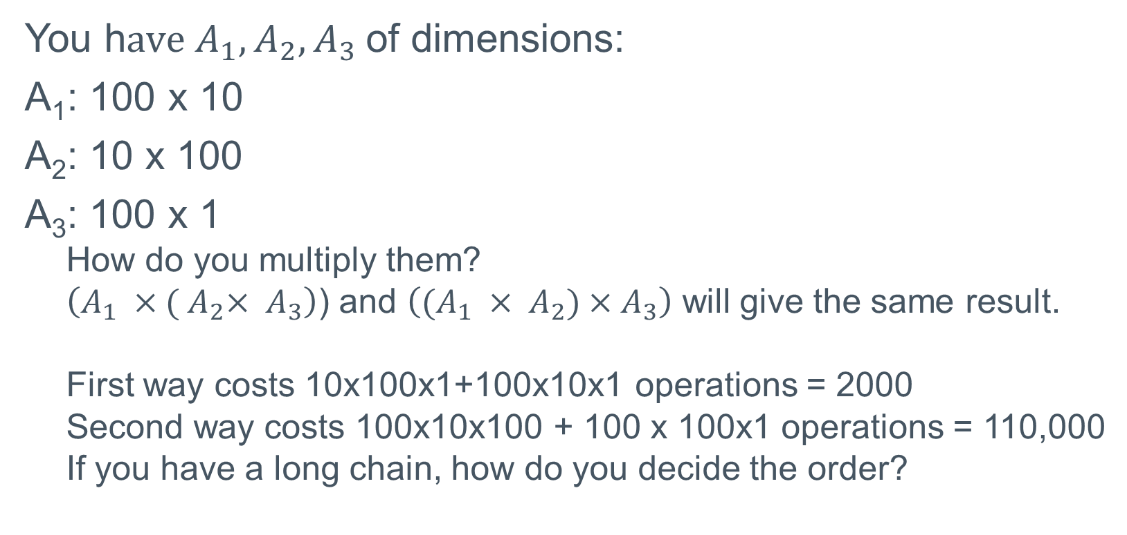
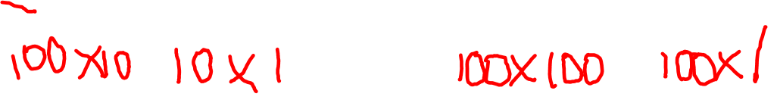
Matrix Chain Multiplication:
You h$ave{ A}_{1},A_{2},A_{3}$of dimensions:
A₁: 100 x 10
A₂: 10 x 100
A₃: 100 x 1
How do you multiply them?
$\left(A_{1} ×{( A}_{2}× A_{3}\right)$) and $\left((A_{1} ×{ A}_{2})×A_{3}\right)$ will give the same result.
First way costs 10x100x1+100x10x1 operations = 2000
Second way costs 100x10x100 + 100 x 100x1 operations = 110,000
If you have a long chain, how do you decide the order?

Slide 4
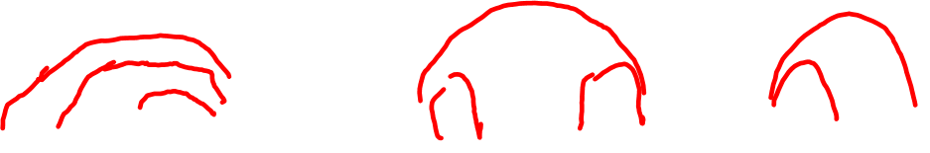
Different Ways of Multiplying a Chain of Matrices
You have A B C D E F G
A few ways:
(A (B (C (D (E (F G)))))), (((A B) (C D)) ((E F) G)),
((A B) ((C D) E) (F G)), (A (B (((C D) E) F) G)),
and many, many more.
Too many to exhaustively search.

Slide 5
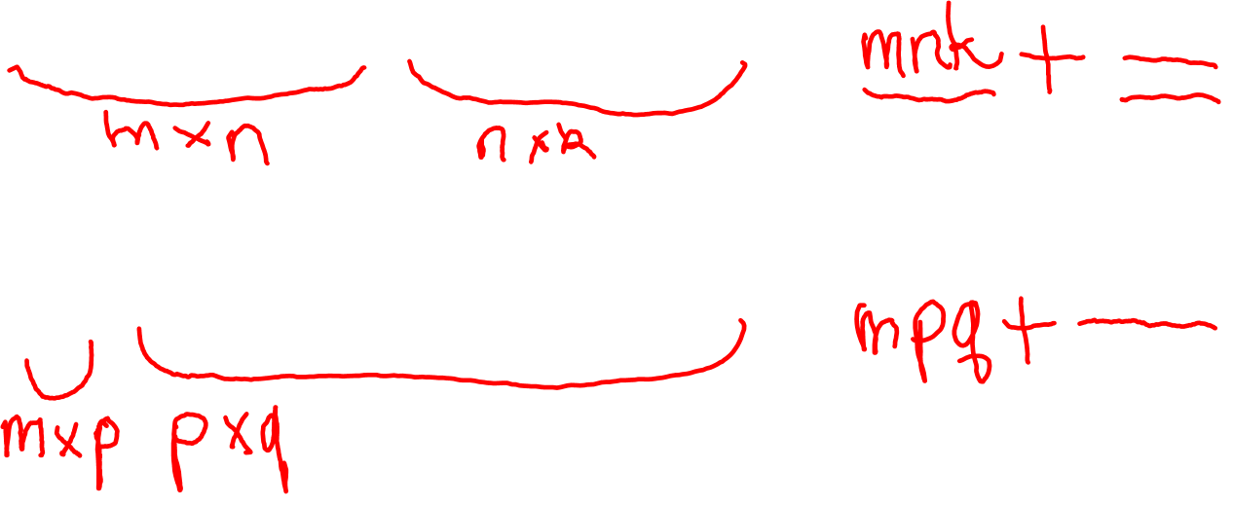
Matrix Chain Multiplication Divide and Conquer
Since we cannot exhaustively search, we will look for dividing the problem into smaller subproblems.
Idea: Divide the chain into smaller chains by looking at the last multiplication. Consider the cost.
((A x (B x C)) x (D x (E x F))
(A x (B x (C x (D x (E x F)))))

Slide 6
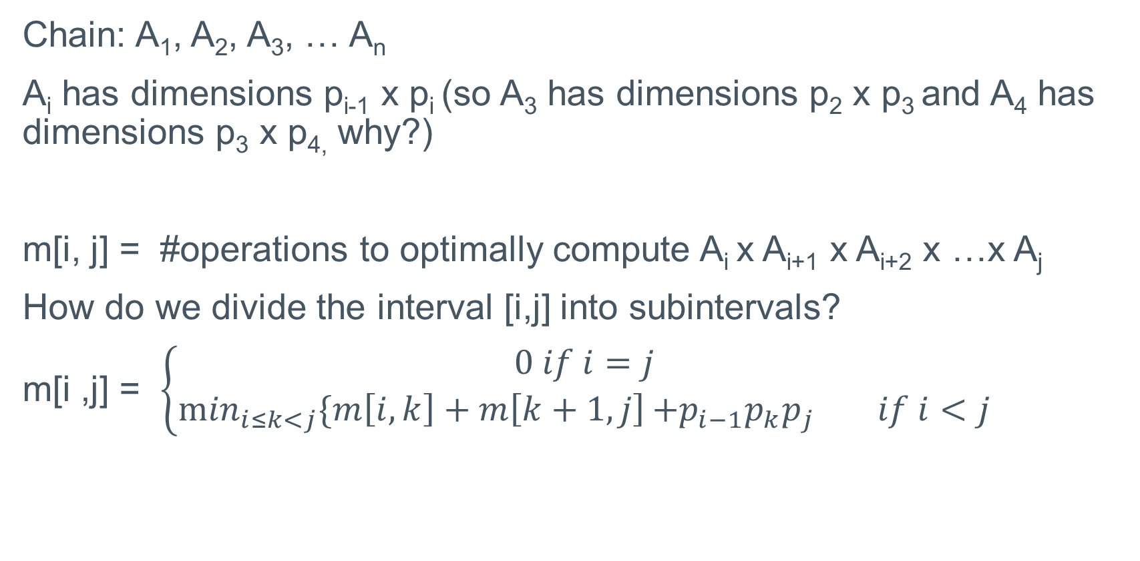
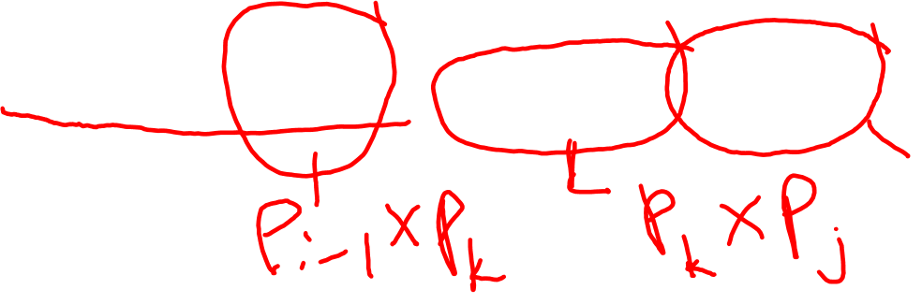
Matrix Chain Multiplication: Substructure
Chain: A₁, A₂, A₃, … A_{n}
A_{i} has dimensions p_{i-1} x p_{i} (so A₃ has dimensions p₂ x p₃ and A₄ has dimensions p₃ x p_{4,} why?)
m[i, j] = #operations to optimally compute A_{i} x A_{i+1} x A_{i+2} x …x A_{j}
How do we divide the interval [i,j] into subintervals?
m[i ,j] = $\left\{\begin{aligned}0 if i=j \\ \min_{i≤k<j}\{m\left[i,k\right]+m\left[k+1,j\right]{{+p}_{i−1}p_{k}p_{j}} if i<j\end{aligned}\right.$

Slide 7
Matrix Chain Multiplication: Memoization
How would you memoize the above?
You need to keep m[i, j] in an array.
In what order will the array get filled? See Figure 15.5 in CLRS

Slide 8
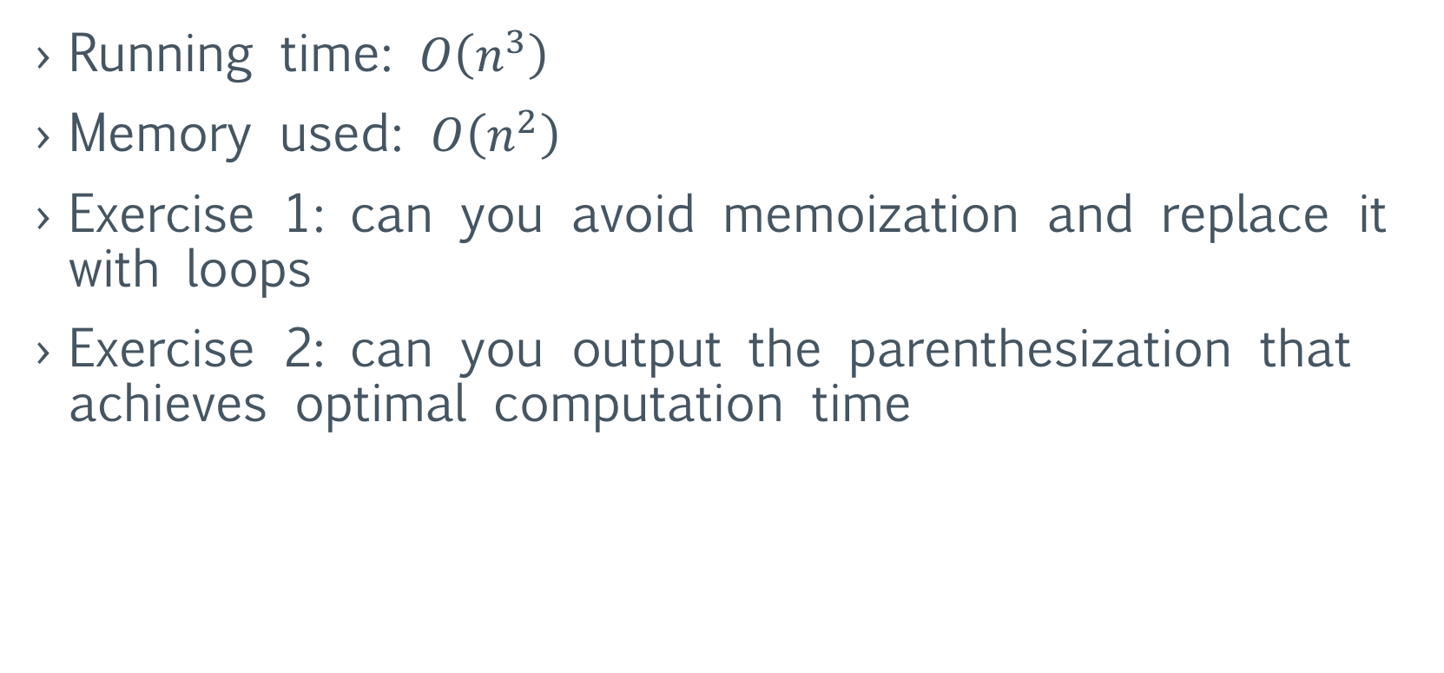
Matrix Chain Multiplication: Dynamic Programming
Running time: $O\left(n^{3}\right)$
Memory used: $O\left(n^{2}\right)$
Exercise 1: can you avoid memoization and replace it with loops
Exercise 2: can you output the parenthesization that achieves optimal computation time

Slide 9
Exercise
How would you count the number of parenthesizations via dynamic programming?

